Slide 1

.
ICU ZAMBIA
Mr Kaela Kamweneshe
kamweneshek@gmail.com
+260955085692/+260978681285

Slide 2
JULY, 2018
ENVIRONMENTAL
CHEMISTRY
.

Slide 3
Course Outline:
TOPIC 1: CHAPTER 1: INTRODUCTION TO ENVIRONMENTAL CHEMISTRY 1 Chemistry and Environmental Chemistry 2 The Building Blocks of Matter 3 Chemical Bonds, Compound Formation and Octet Rule
TOPIC 2: CHAPTER 2: ACIDS, BASES, AND SALTS 1 The Importance and nature of Acids, Bases, and Salts 2 Dissociation of Acids and Bases in Water 3 pH and the Relationship Between Hydrogen Ion and Hydroxide Ion Concentrations 4 Preparation of Acids, Bases and Salts
WEEK 3:
TOPIC 3: CHAPTER 3: SOLUTIONS 1 The Solution Process, Solubility and Concentration 2 Standard Solutions and Titrations 3 Solution Equilibria 4 Colloidal Suspensions Onlines Sources

Slide 4
Course Outline : contn.
WEEK 4:
TOPIC: 4) CHAPTER 4: ENVIRONMENTAL CHEMISTRY OF WATER 1 Aquatic Chemistry 2 Metal Ions and Calcium in Water 3 Oxidation-Reduction - Complexation and Chelation and Water Interactions with Other Phases
WEEK 5:
TOPIC 5: CHAPTER 5: WATER POLLUTION 1 Nature and Types of Water Pollutants 2 Elemental Pollutants, Heavy Metal, Metalloid 3 Organically Bound Metals and Metalloids
WEEK 6:
TOPIC 6: CHAPTER 5: WATER POLLUTION 4 Inorganic Species 5 Oxygen, Oxidants, and Reductants 6 Organic Pollutants, Pesticides in Water and Polychlorinated Biphenyls

Slide 5
Course Outline : contn.
TOPIC 6: CHAPTER 6: THE ATMOSPHERE AND ATMOSPHERIC CHEMISTRY 1 The Atmosphere and Atmospheric Chemistry 2 Physical Characteristics of the Atmosphere 3 Energy Transfer in the Atmosphere 4 Atmospheric Mass Transfer, Meteorology, and Weather
TOPIC 6: CHAPTER 6: THE ATMOSPHERE AND ATMOSPHERIC CHEMISTRY
5 Inversions and Air Pollution 6 Chemical and Photochemical Reactions in the Atmosphere 7 Acid–Base Reactions in the Atmosphere 8 Reactions of Atmospheric Oxygen and Nitrogen

Slide 6
Course Outline : contn.
WEEK 9:
TOPIC: CHAPTER 7: SOIL ENVIRONMENTAL CHEMISTRY 1 Nature and Composition of Soil 2 Acid-Base and Ion Exchange Reactions in Soils 3 Macronutrients and Micronutrients in Soil
WEEK 10:
TOPIC: CHAPTER 7: SOIL ENVIRONMENTAL CHEMISTRY 4 Fertilizers 5 Wastes and Pollutants in Soil 6 Soil Loss and Degradation

Slide 7
Introduction to Environmental Chemistry
It means different things to different people. No precise definition.
It is clear that environmental chemists are playing their part in the big environmental issues—stratospheric ozone (O3) depletion, global warming and the like.
Similarly, the role of environmental chemistry in regional-scale and local problems—for example, the effects of acid rain or contamination of water resources—is well established.
There is a clear link in our minds between environmental chemistry and human beings.
For many people, ‘environmental chemistry’ is implicitly linked to ‘pollution’.

Slide 8
THE IMPORTANCE OF ACIDS, BASES, AND SALTS
Almost all inorganic compounds and many organic compounds can be classified as acids, bases, or salts. Some of these types of compounds were mentioned in earlier chapters and are discussed in greater detail in this chapter.
Acids, bases, and salts are vitally involved with life processes, agriculture, industry, and the environment.
The most widely produced chemical is an acid, sulfuric acid. The second-ranking chemical, lime, is a base.
Another base, ammonia, ranks fourth in annual chemical production.
Among salts, sodium chloride is widely produced as an industrial chemical, potassium chloride is a source of essential potassium fertilizer , and sodium carbonate is used in huge quantities for glass and paper manufacture, and for water treatment.

Slide 9
THE IMPORTANCE OF ACIDS, BASES, AND SALTS
The salt content and the acid–base balance of blood must stay within very narrow limits to keep a person healthy, or even alive.
Soil with too much acid or excessive base will not support good crop growth. Too much salt in irrigation water may prevent crops from growing.
This is a major agricultural problem in arid regions of the world such as the mid-East and California’s Imperial Valley.
The high salt content of irrigation water discharged to the Rio Grande River has been a source of dispute between the U.S. and Mexico that has been resolved to a degree by installation of a large desalination (salt removal) plant by the U.S.
From the above discussion it is seen that acids, bases and salts are important to human health and welfare. This chapter discusses their preparation, properties, and naming.

Slide 10
THE NATURE OF ACIDS, BASES, AND SALTS Hydrogen Ion and Hydroxide Ion
Recall that an ion is an atom or group of atoms having an electrical charge.
In discussing acids and bases 2 very important ions are involved.
One of these is the hydrogen ion, H⁺. It is always produced by acids.
The other is the hydroxide ion, OH⁻. It is always produced by bases. These two ions react together, to produce water.
H⁺ + OH⁻ →H₂O
This is called a neutralization reaction. It is one of the most important of all chemical reactions.

Slide 11

Acids
An acid is a substance that produces hydrogen ions. For example, HCl in water is entirely in the form of H+ ions and Cl- ions.
These 2 ions in water form hydrochloric acid. Acetic acid, which is present in vinegar, also produces hydrogen ions in water:
Acetic acid demonstrates two important characteristics of acids.
First, many acids contain H that is not released by the acid molecule to form H+.
Of the 4 hydrogens in CH₃CO₂H, only the one bonded to oxygen is ionizable to form H+.
The second important point about acetic acid has to do with how much of it is ionized to form H⁺ and acetate ion, CH₃CO₂²⁻.
Most of the acetic acid remains as molecules of CH₃CO₂H in solution.

Slide 12
.
In a 1 molar solution of acetic acid (containing 1 mol of acetic acid per liter of solution) only about 0.5% of the acid is ionized to produce an acetate ion and a hydrogen ion.
Of a thousand molecules of acetic acid, 995 remain as unionized CH₃CO₂H. Therefore, acetic acid is said to be a weak acid.
A hydrogen ion in water is strongly attracted to water molecules. Hydrogen ions react with water,
Hydronium ion, H₃O⁺ or clusters with even more water molecules such as H₅O₂⁺ or H₇O₃⁺.
The hydrogen ion in water is frequently shown as H₃O⁺. In this lesson, however, it is simply indicated as H⁺.

Slide 13

Hydronium Ion

Slide 14
Bases
A base is a substance that produces hydroxide ion and/or accepts H+.
Many bases consist of metal ions and hydroxide ions. For example, solid sodium hydroxide dissolves in water, to yield a solution containing OH- ions.
NaOH(s) → Na⁺(aq) + OH⁻(aq)
When ammonia gas is bubbled into water, a few of the NH3 molecules remove hydrogen ion from water and produce ammonium
ion, NH4 +, and hydroxide ion as shown by the following reaction:
NH3 + H₂O → NH4 ⁺ + OH⁻
Only about 0.5% of the ammonia in a 1M solution goes to NH4 ⁺ and OH⁻.
Therefore, NH3 is called a weak base.

Slide 15
Salts
Whenever an acid and a base are brought together, water is always a product.
But a negative ion from the acid and a positive ion from the base are always left over as shown in the following reaction:
H⁺ + Cl⁻ + Na⁺ + OH⁻ → Na⁺ + Cl⁻ + H2O
(hydrochloric acid + sodium hydroxide yields sodium chloride +water.
Sodium chloride dissolved in water is a solution of a salt. A salt is made up of a positively charged ion called a cation and a negatively charged ion called an anion.
If the water were evaporated, the solid salt made up of cations and anions
would remain as crystals.
A salt is a chemical compound made up of a cation (other than H+) and an anion (other than OH-).

Slide 16
Amphoteric Substances
Some substances, called amphoteric substances, can act both as an acid and a base.
The simplest example is water. Water can split apart to form a hydrogen ion and a hydroxide ion.
H2O → H⁺ + OH⁻
Since it produces a hydrogen ion, water is an acid. However, the fact that it produces a hydroxide ion also makes it a base.
This reaction occurs only to a very small extent. In pure water only one out of 10 million molecules of water is in the form of
H⁺ and OH⁻.
Except for this very low concentration of these two ions that can exist together, H⁺ and OH⁻ react strongly with each other to form water.

Slide 17

.
Another important substance that can be either an acid or base is glycine.
Glycine is one of the amino acids that is an essential component of the body’s protein.
It can give off a hydrogen ion

Slide 18

.
or it can react with water to release a hydroxide ion from the water:

Slide 19
Metal Ions as Acids
Some metal ions are acids. As an example, consider iron(III) ion, Fe3+.
This ion used to be commonly called ferric ion. When iron(III) chloride, FeCl3, is dissolved in water, it produces chloride ions and triply charged iron(III) ions.
FeCl3 + 6H₂O →Fe(H2O)₆ ³⁺ + 3Cl⁻
Each iron(III) ion is bonded to 6 water molecules.
The iron(III) ion surrounded by water is called a hydrated ion.
This hydrated iron(III) ion can lose hydrogen ions and form a slimy brown precipitate of iron(III) hydroxide, Fe(OH)3:
Fe(H₂O)₆ ³⁺ → Fe(OH)₃ + 3H₂O + 3H⁺

Slide 20
.
It is this reaction that is partly responsible for the acid in iron-rich acid mine water.
It is also used to purify drinking water.
The gelatinous Fe(OH)3 settles out, carrying the impurities to the bottom of the container, and the water clears up.

Slide 21
Salts that Act as Bases
Some salts that do not contain hydroxide ion but produce this ion in solution.
The most widely used of these is sodium carbonate, Na2CO3, which is commonly known as soda ash.
Millions of pounds of soda ash are produced each year for the removal
of hardness from boiler water, for the treatment of waste acid, and for many other industrial processes. Sodium carbonate reacts in water to produce hydroxide ion.
2Na⁺ + CO3 ²⁻ + H2O → Na⁺ + HCO3 ⁻ + Na⁺ + OH⁻
If H+, such as from hydrochloric acid, is already present in the water, sodium carbonate reacts with it as follows:
2Na⁺ + CO3 ²⁻ + H⁺ + Cl⁻ → Na⁺ + Cl⁻ + Na⁺ + HCO3 ⁻
sodium carbonate
sodium bicarbonate
sodium hydroxide
sodium carbonate
hydrochloric acid
sodium chloride
sodium bicarbonate

Slide 22
Salts that Act as Acids
Some salts act as acids. Salts that act as acids react with hydroxide ions.
Ammonium chloride, NH4Cl, is such a salt. This salt is also called “sal ammoniac.”
As a “flux” added to solder used to solder copper plumbing or automobile radiators, ammonium chloride dissolves coatings of corrosion on the metal surfaces so that the solder can stick.
In the presence of a base, NH4Cl reacts with the hydroxide ion to produce ammonia gas and water.
NH4 ⁺ + Cl⁻ + Na⁺ + OH⁻ →NH3 ⁺ H⁺ + OH⁻ + Na⁺ + Cl⁻
ammonium chloride
sodium hydroxide
sodium chloride

Slide 23
CONDUCTANCE OF ELECTRICITY BY ACIDS, BASES, AND SALTS IN SOLUTION
When acids, bases, or salts are dissolved in water, charged ions are formed.
When HCl gas is dissolved in water, all of it goes to H+ and Cl- ions
HCl(g) Water → H+(aq) + Cl-(aq)
Acetic acid in water also forms a few ions, but most of it stays as CH₃CO₂H.
CH₃CO₂H Water → H⁺ + CH₃CO₂ –
Sodium hydroxide in water is all in the form of Na+ and OH- ions.
The salt, NaCl, is all present as Na+ and Cl- ions in water.

Slide 24
Electricity Conductivity of Ions
One of the most important properties of ions is that they conduct electricity in water.
Water containing ions from an acid, base, or salt will conduct electricity much like a metal wire.
Consider what would happen if very pure distilled water were made part of an electrical circuit as shown in Figure 6.2.
The light bulb would not glow at all. This is because pure water does not conduct electricity.
However, if a solution of salt water, such as oil well brine, is substituted for the distilled water, the bulb will glow brightly, as shown in Figure 6.2. Salty water conducts electricity because of the ions that it contains.
Even tap water has some ions dissolved in it, which is why one may experience a painful, even fatal, electric shock by touching an electrical fixture while bathing.

Slide 25
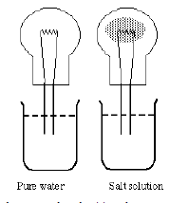
Electricity Conduction in Pure and Salty Water

Slide 26
Electrolytes
Materials that conduct electricity in water are called electrolytes. These materials form ions in water.
The charged ions allow the electrical current to flow through the water.
Materials, such as sugar, that do not form ions in water are called non-electrolytes.
Solutions of nonelectrolytes in water do not conduct electricity. A
solution of brine conducts electricity very well because it contains dissolved NaCl ions.
All of the NaCl in the water is in the form of Na+ and Cl-. The NaCl is completely ionized, and it is a strong electrolyte.
An ammonia water solution (used for washing windows) does not conduct electricity very well. That is because only a small fraction of the NH3 molecules react, to form the ions that let electricity pass through the water.
NH3 + H2O → NH4 ⁺ + OH⁻

Slide 27
,
Ammonia is a weak electrolyte. (Recall that it is also a weak base).
Nitric acid, HNO₃ is a strong electrolyte because it is completely ionized to H+ and NO3- ions.
Acetic acid is a weak electrolyte, as well as a weak acid.
The base, sodium hydroxide, is a strong electrolyte.
All salts are strong electrolytes because they are always completely ionized in water.
Acids and bases can be weak or strong electrolytes.

Slide 28
.
In the laboratory, the strength of an electrolyte can be measured by how well it conducts electricity in solution, as shown in Figure 6.3.
The ability of a solution to conduct electrical current is called its conductivity.
When electricity is passed through solutions of acids, bases, or salts, chemical reactions occur.
One such reaction is the breakdown of water to hydrogen and oxygen.
Electricity passing through a solution is widely used to separate and purify various substances.

Slide 29
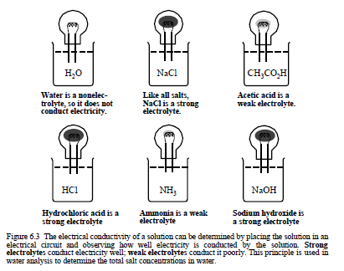
Conduction of Electricity of Different Electrolytes

Slide 30
DISSOCIATION OF ACIDS AND BASES IN WATER
It has already been seen that acids and bases come apart in water to form ions.
When acetic acid splits up in water, it forms hydrogen ions and acetate ions.
CH₃CO₂H →CH₃CO₂ ⁻ + H⁺
The process of forming ions is called ionization.
Another term is commonly employed.
When the acetic acid molecule comes apart, it is said to dissociate.
The process is called dissociation.
There is a great difference in how much various acids and bases dissociate.
Some, like HCl or NaOH, are completely dissociated in water.
Because of this, hydrochloric acid is called a strong acid.
Sodium hydroxide is a strong base.
Some acids such as acetic acid are only partly dissociated in water.
They are called weak acids.
Ammonia, NH3, reacts only a little bit in water to form an ammonium ion (NH4 ⁺) and a hydroxide ion (OH-). It is a weak base.

Slide 31
.
The extent of dissociation is a very important property of an acid or base.
The 3% or so acetic acid solution used to make up oil and vinegar salad dressing lends a pleasant taste to the lettuce and tomatoes.
There is not much of the H⁺ ion in the acetic acid. If 3% HCl had been used instead, nobody could eat the salad.
All of the H in HCl is in the form of H⁺, and a 3% solution of hydrochloric acid is very sour indeed.
Similarly, a several percent solution of NH3 in water makes a good window washing agent, helping to dissolve grease and grime on the window surface.
If a similar concentration of sodium hydroxide were used to clean windows, they would soon become permanently fogged because the OH⁻ in the strong base eventually reacts with glass and etches it.
However, sodium hydroxide solutions are used to clean ovens, where a very strong base is required to break down the charred, baked-on grease.

Slide 32
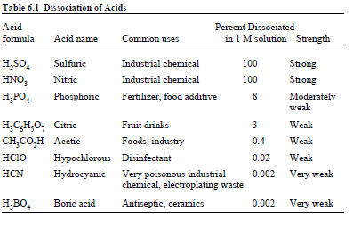
Some acids and the degree to which they are dissociated. It allows comparison of the strengths of these acids.

Slide 33
.
The percentage of acid molecules that are dissociated depends upon the concentration of the acid in water.
The lower the concentration, the higher the percentage of dissociated molecules.
This may be understood by looking again at the reaction, for the dissociation of acetic acid.
CH₃CO₂H → CH₃CO₂⁻ + H⁺
At high concentrations, there will be more crowding together of H+ and CH3CO2 - ions.
This forces them back together to form CH3CO2H again.
At low concentrations, there are fewer H+ and CH3CO2 - ions.
They are more free to roam around the solution alone, and there is less pressure for them to form CH3CO2H.

Slide 34
.
It is somewhat like the seating which occurs on a bus. If there are few passengers, they will spread out and not sit next to each other, that is, they will be dissociated.
If there are many passengers, they will, of course, have to occupy adjacent seats.
An idea of the effect of concentration upon the dissociation of a weak acid can be obtained from the percentage of acid molecules that have dissociated to ions at several different concentrations.
This is shown for acetic acid in Table .

Slide 35
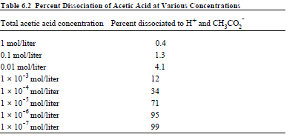
Percentage Dissociation of Acetic Acid at Various Concentrations

Slide 36
.
Table 6.2 above shows that, in a 1 M solution, less than 1% of acetic acid is dissociated.
In a one-thousandth M (0.001 M) solution, 12 out of 100 molecules of acetic acid are in the form of H⁺ and acetate ions.
In a one-millionth M (0.000001 M) solution only 5 out of 100 acetic acid molecules are present as CH₃CO₂H.
It is important to know the difference between the strength of an acid or base in solution and the concentration of the solution.
A strong acid is one that is all in the form of H⁺ ions and anions. It may be very concentrated or very dilute.
A weak acid does not give off much H⁺ to water solution.
It may also range in concentration from a very dilute solution to a very concentrated one. Similar arguments apply to bases.

Slide 37
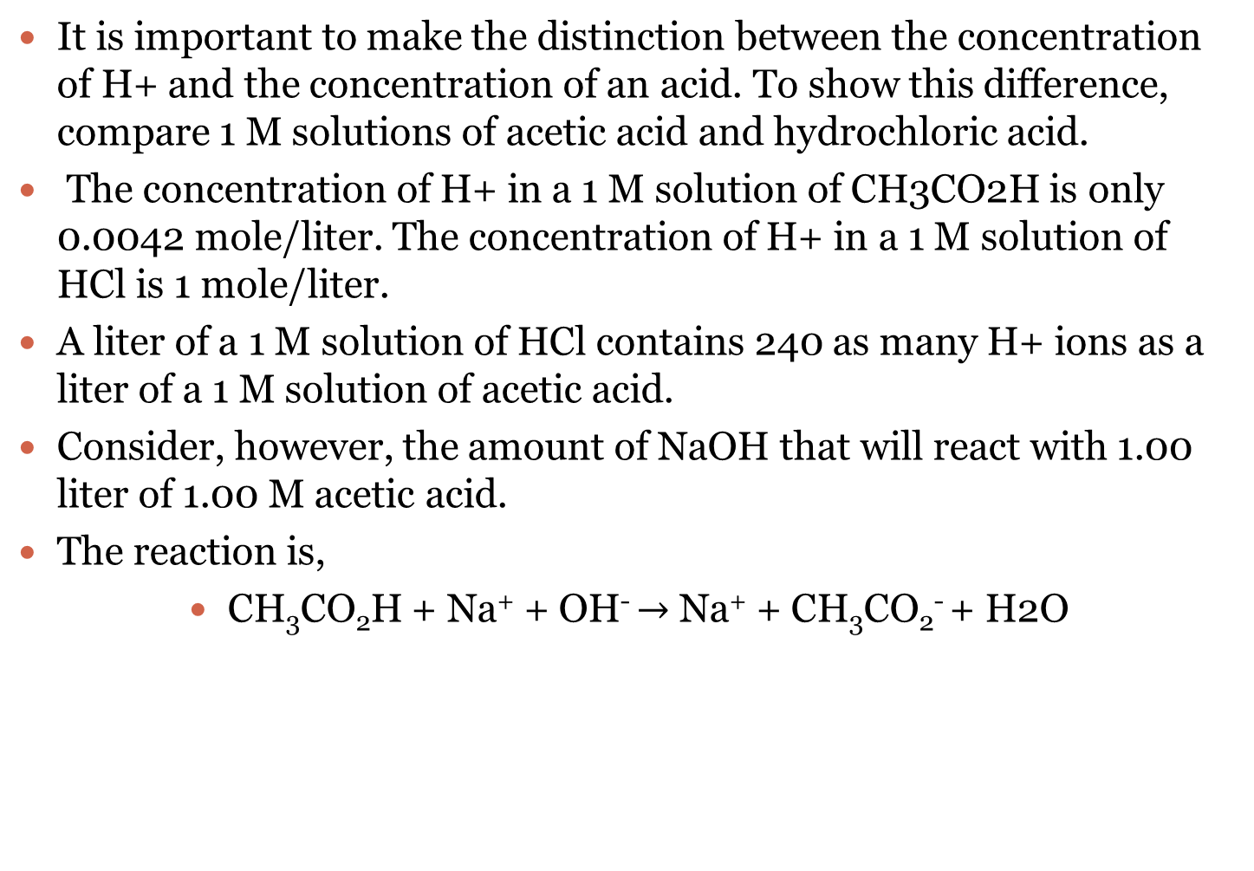
THE HYDROGEN ION CONCENTRATION AND BUFFERS
It is important to make the distinction between the concentration of H+ and the concentration of an acid. To show this difference, compare 1 M solutions of acetic acid and hydrochloric acid.
The concentration of H+ in a 1 M solution of CH3CO2H is only 0.0042 mole/liter. The concentration of H+ in a 1 M solution of HCl is 1 mole/liter.
A liter of a 1 M solution of HCl contains 240 as many H+ ions as a liter of a 1 M solution of acetic acid.
Consider, however, the amount of NaOH that will react with 1.00 liter of 1.00 M acetic acid.
The reaction is,
CH₃CO₂H + Na⁺ + OH⁻ $→$ Na⁺ + CH₃CO₂⁻ + H2O
Acetic acid
Sodium hydroxide
Sodium acetate
Water

Slide 38
.
Exactly 1.00 mole of NaOH reacts with the 1.00 mole of acetic acid contained in a liter of a 1.00 M solution of this acid.
Exactly the same amount of NaOH reacts with the HCl in 1.00 liter of 1.00 M HCl.
H⁺ + Cl⁻ + Na⁺ + OH⁻ → Na⁺ + Cl⁻ + H2O
Hydrochloric acid
Sodium Hydroxide
Sodium Chloride
Water

Slide 39
.
Therefore, even though acetic acid is a weaker acid than hydrochloric acid, equal volumes of each, with the same molar concentration, will react with the same number of moles of base.
In many systems the concentration of H⁺ is very important.
For a person to remain healthy the H⁺ concentration in blood must stay within a very narrow range.
If the H+ concentration is too high in a boiler system, the pipes may become corroded through in a short time.
If the H⁺ concentration becomes too high or too low in a lake, plant and animal life cannot thrive in it.

Slide 40
Buffers
Fortunately, there are mixtures of chemicals that keep the H+ concentration of a solution relatively constant.
Reasonable quantities of acid or base added to such solutions do not cause large changes in H⁺ concentration. Solutions that resist changes in H+ concentration are called buffers.
To understand how a buffer works, consider a typical buffer system.
A solution containing both acetic acid and sodium acetate is a good buffer. The acetic acid in the solution is present as undissociated CH3CO2H.
The H+, which is in solution, is there because a very small amount of the CH3CO2H has dissociated to H+ and CH3CO2 - ions.
The sodium acetate is present as Na+ ion and CH3CO2 - ion.
If some base, such as NaOH, is added, some of the acetic acid reacts.
CH₃CO₂H + Na⁺ + OH⁻ → Na⁺ + CH₃CO₂ ⁻ + H₂O
Acetic Acid
Sodium Hydroxide
Sodium acetate
Water

Slide 41
.
This reaction changes some of the acetic acid to sodium acetate, but it does not change the hydrogen ion concentration much.
If a small amount of hydrochloric acid is added to the buffer mixture of acetic acid and sodium acetate, some of the sodium acetate is changed to acetic acid.
The acetate ion acts like a sponge for H+ and prevents the concentration of the added hydrogen ion from becoming too high.
Na⁺ + CH₃CO₂ ⁻ + H⁺ + Cl⁻ → CH₃CO₂H ⁺ Na⁺ + Cl⁻
sodium acetate
sodium acetate
Acetic acid
Sodium Chloride

Slide 42
.
Buffers can also be made from a mixture of a weak base and a salt of the base.
A mixture of ,
NH₃ and NH₄Cl is such a buffer.
Mixtures of two salts can be buffers.
A mixture of ,
NaH₂PO₄ and Na₂HPO₄ is a buffer made from salts.
It is one of the very common phosphate buffers, such as those that occur in body fluids.

Slide 43
pH AND THE RELATIONSHIP BETWEEN HYDROGEN ION AND HYDROXIDE ION CONCENTRATIONS
Because of the fact that water itself produces both hydrogen ion and hydroxide ion there is always some H+ and some OH- in any solution.
H₂O → H⁺ + OH⁻
Of course, in an acid solution, the concentration of OH- must be very low. In a solution of base the concentration of OH- is very high and that of H+ is very low.
There is a definite relationship between the concentration of H+ and the concentration of OH-.
It varies a little with temperature. At 25°C (about room temperature) the following relationship applies:
[H⁺][OH⁻] = 1.00 x 10⁻¹⁴ = Kw (at 25°C)
If the value of either [H⁺] or [OH-] is known, the value of the other can be calculated by substituting into the Kw expression.

Slide 44

EG,
For example, in a solution of 0.100 M HCl in which [H⁺] = 0.100 M,
[OH-] = $\frac{\text{K}\text{w}}{\text{[}\text{H}\text{+}\text{]}}$ = $\frac{\text{1.00 }\text{x}\text{ 10−14}}{0.100}$= 1.00 x 10⁻¹³ M

Slide 45
.
Acids, such as HCl and H₂SO₄, produce more H+ ion, whereas bases, such as sodium hydroxide and calcium hydroxide (NaOH and Ca(OH)₂, respectively), produce more hydroxide ion, OH⁻.
Molar concentrations of hydrogen ion, [H⁺], range over many orders of magnitude and are conveniently expressed by pH defined as
pH = -log[H⁺]

Slide 46
.
In absolutely pure water the value of [H⁺] is exactly 1 x 10 ⁻⁷ mole/L;
therefore, the pH of pure water is 7.00, and the solution is neutral (neither acidic nor basic).
Acidic solutions have pH values of less than 7 and basic solutions have pH values of greater than 7.
Table 6.3 gives some example hydrogen ion concentrations and the corresponding pH values.

Slide 47
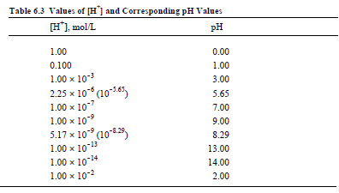
Value of Hydrogen Ion Conc and Corr pH Values
,
Notes:
Question. Find the pH Values of solutions the following [H⁺] concentrations.

Slide 48
.
As seen in Table 6.3, when the H+ ion concentration is 1 times 10 to a power (the superscript number, such as -2, -7, etc.) the pH is simply the negative value of that power.
Thus, when [H⁺] is 1 x 10-3, the pH is 3; when [H⁺] is 1 x 10⁻⁴, the pH is 4. That is because the log of 1 x 10⁻³ is -3 and that of 1x10⁻⁴ is -4. Therefore, the negative logs are 3 and 4, respectively, because the sign is reversed.
What about the pH of a solution with a hydrogen ion concentration between 1 x 10⁻⁴ and 1 x 10⁻³, such as 3.16 x 10⁻⁴?
Since [H⁺] is between 1 x 10⁻⁴ and 1 x 10⁻³ M, the pH is obviously going to be between 3 and 4.
The pH is calculated very easily on an electronic calculator by entering 3.16 x 10⁻⁴ on the keyboard and pressing the “log” button.
The log of the number is -3.50, and the pH is 3.50.

Slide 49
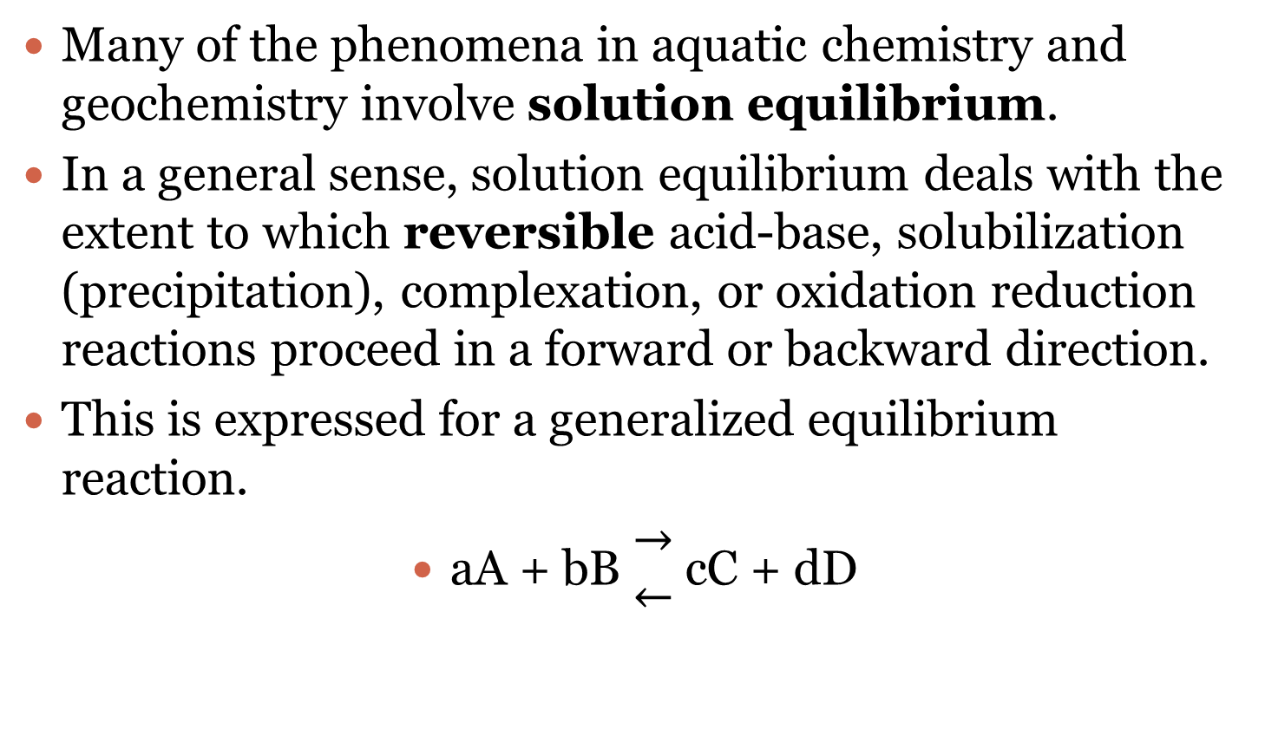
Acid-Base Equilibria
Many of the phenomena in aquatic chemistry and geochemistry involve solution equilibrium.
In a general sense, solution equilibrium deals with the extent to which reversible acid-base, solubilization (precipitation), complexation, or oxidation reduction reactions proceed in a forward or backward direction.
This is expressed for a generalized equilibrium reaction.
aA + bB $\begin{matrix}→ \\ ←\end{matrix}$cC + dD

Slide 50

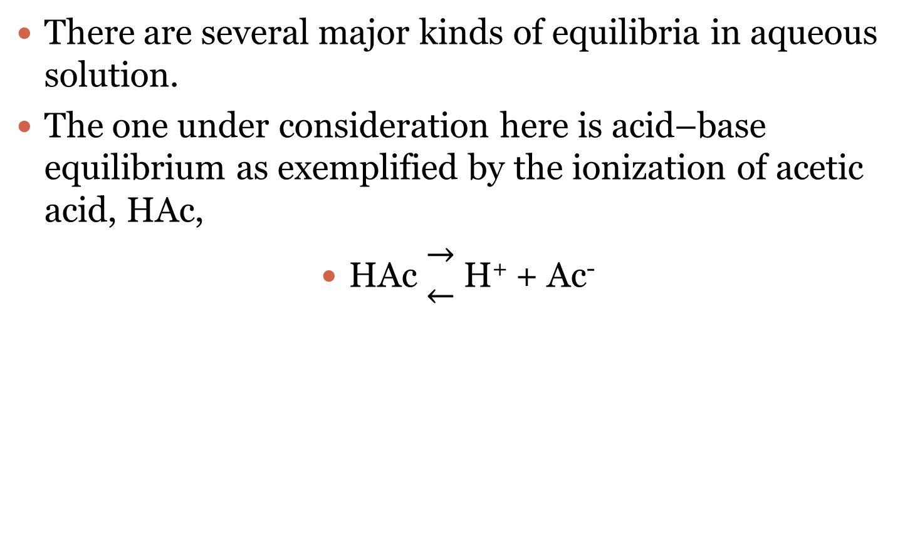
.
There are several major kinds of equilibria in aqueous solution.
The one under consideration here is acid–base equilibrium as exemplified by the ionization of acetic acid, HAc,
HAc $\begin{matrix}→ \\ ←\end{matrix}$H⁺ + Ac⁻

Slide 51

.
for which the acid dissociation constant for acetic acid is
$\frac{ \text{[}\text{H}\text{+][}\text{Ac}\text{−]}}{\text{[}\text{HAc}\text{] }}$= K_{a} = 1.75 x 10⁻⁵ (at 25°C)

Slide 52
.
As an example of an acid–base equilibrium problem, consider water in equilibrium with atmospheric carbon dioxide.
The value of [CO2(aq)] in water at 25°C in equilibrium with air that is 350 parts per million CO2 (close to the concentration of this gas in the atmosphere) is 1.146 x 10⁻⁵ moles/liter (M).
The carbon dioxide dissociates partially in water to produce equal concentrations of H+ and HCO₃ ⁻:

Slide 53
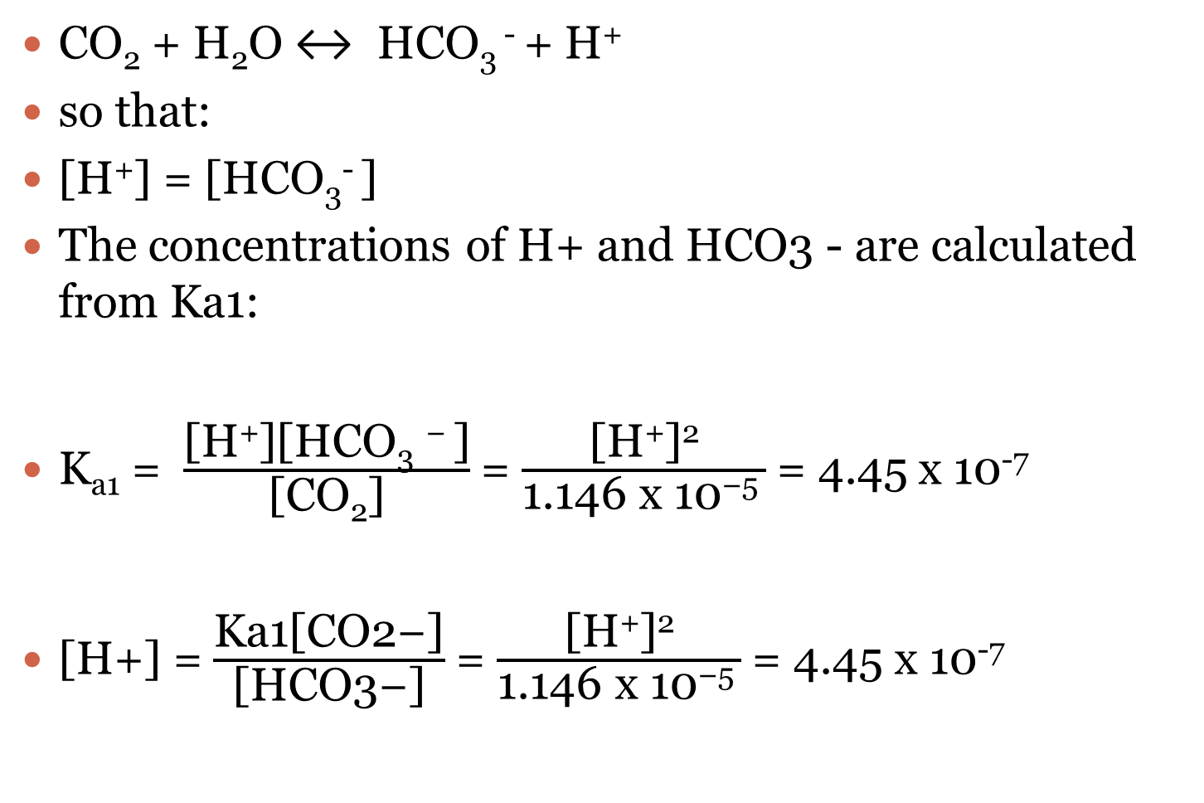
.
CO₂ + H₂O ↔ HCO₃ ⁻ + H⁺
so that:
[H⁺] = [HCO₃⁻ ]
The concentrations of H+ and HCO3 - are calculated from Ka1:
K_{a1} = $\frac{\text{[}\text{H}\text{+}\text{][}\text{HCO}\text{3} \text{− }\text{]}}{\text{[}\text{CO}\text{2}\text{]}}$= $\frac{\text{[}\text{H}\text{+}\text{]}\text{2}}{\text{1.146 }\text{x}\text{ 10−5 }}$= 4.45 x 10⁻⁷
[H+] = $\frac{\text{Ka}\text{1[}\text{CO}\text{2−]}}{\text{[}\text{HCO}\text{3−]}}$= $\frac{\text{[}\text{H}\text{+}\text{]}\text{2}}{\text{1.146 }\text{x}\text{ 10−5 }}$= 4.45 x 10⁻⁷

Slide 54
.
Since [H+] = [HCO3 -], this relationship simplifies to
[H+] = [HCO3 -] = (1.146 x 10⁻⁵ x 4.45 x 10⁻⁷)^{1/2} = 2.25 x 10⁻⁶
pH = 5.65
This calculation explains why pure water that has equilibrated with the unpolluted atmosphere is slightly acidic, with a pH somewhat less than 7.

Slide 55
PREPARATION OF ACIDS, BASES AND SALTS
1-PREPARATION OF ACIDS
Acids can be prepared in several ways. In discussing their preparation, it is important to keep in mind that acids usually contain nonmetals.
All acids either contain ionizable hydrogen or produce it when dissolved in water.
Furthermore, the hydrogen has to be ionizable; it must have the ability to from H+ ion. Finally, more often than not, acids contain oxygen.
A simple way to make an acid is to react hydrogen with a nonmetal that forms a compound with hydrogen that will form H+ ion in water.
Hydrochloric acid can be made by reacting hydrogen and chlorine and adding the hydrogen chloride product to water
H2 + Cl2 → 2HCl

Slide 56
Non-Metals + H2O
Other acids that consist of hydrogen combined with a nonmetal are HF, HBr, HI, and H2S.
Hydrocyanic acid, HCN, is an “honorary member” of this family of acids, even though it contains three elements.
Sometimes a nonmetal reacts directly with water to produce acids.
The best example of this is the reaction of chlorine with water to produce hydrochloric acid and hypochlorous acid.
Cl2 + H2O → HCl + HClO

Slide 57
Non-Metal Oxides + H2O
Many very important acids are produced when nonmetal oxides react with water.
One of the best examples is the reaction of sulfur trioxide with water to produce sulfuric acid.
SO3 + H2O → H2SO4
Other examples are shown in Table .

Slide 58
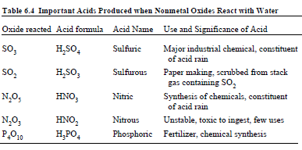
Acids Produced from NM Oxides

Slide 59
Volatile Acids Produced from Non Volatile Acids
Volatile acids—those that evaporate easily—can be made from salts and nonvolatile acids.
The most common nonvolatile acid so used is sulfuric acid, H2SO4.
When solid NaCl is heated in contact with concentrated sulfuric acid,
2NaCl(s) + H2SO4(l) → 2HCl(g) + Na2SO4(s)
HCl gas is given off. This gas can be collected in water to make hydrochloric acid.
Similarly when calcium sulfite is heated with sulfuric acid, sulfur dioxide is given off as a gas. It can be collected in water to produce sulfurous acid, H2SO3.
CaSO3(s) + H2SO4(l) → CaSO4(s) + SO2(g) + H2O

Slide 60

Organic Acids
Organic acids, such as acetic acid, CH3CO2H, have the group carboxyl attached to a hydrocarbon group.
These carboxylic acids are discussed further in later chapters

Slide 61
PREPARATION OF BASES
Bases can be prepared in several ways. Many bases contain metals and some metals react directly with water to produce a solution of base.
Lithium, sodium, and potassium react very vigorously with water to produce their hydroxides Plus Hydrogen gas:
K + 2H2O → K²⁺ + 2OH⁻ + H2(g)
potassium hydroxide
(strong base)

Slide 62
Metal Oxides + H2o=Base
Many metal oxides form bases when they are dissolved in water.
When waste liquor (a concentrated solution of salts and materials extracted from wood) from the sulfite paper-making process is burned to produce energy and reclaim magnesium hydroxide, the magnesium in the ash is recovered as MgO.
MgO + H2O → Mg(OH)2
This is added to water to produce the magnesium hydroxide used with other chemicals to break down the
wood and produce paper fibers.
Other important bases and the metal oxides from which they are prepared are given in Table below

Slide 63
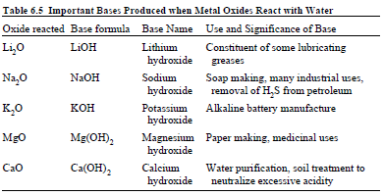
Bases from Metal Oxides

Slide 64
.
Many important bases cannot be isolated as the hydroxides but produce OH- ion in water. A very good example is ammonia, NH3.
Ammonium hydroxide, NH4OH, cannot be obtained in a pure form.
Even when ammonia is dissolved in water, very little NH4OH is present in the solution. However, ammonia does react with water, to give an ammonium ion and a hydroxide ion
NH3 + H2O → NH4 + + OH-
Since only a small percentage of the ammonia molecules react this way, ammonia is a weak base.

Slide 65
.
Many salts that do not themselves contain hydroxide ion act as bases by reacting with water to produce OH-.
Sodium carbonate, Na2CO3, is the most widely used of these salts.
When sodium carbonate is placed in water, the carbonate ion reacts with water to form a hydroxide ion and a bicarbonate ion (HCO₃⁻)
CO₃ ²⁻ + H₂O → HCO₃⁻ + OH⁻

Slide 66
.
Commercial grade sodium carbonate, soda ash, is used very widely for neutralizing acid in water treatment and other applications.
It is used in phosphate-free detergents. It is a much easier base to handle and use than sodium hydroxide.
Whereas sodium hydroxide rapidly absorbs enough water from the atmosphere to dissolve itself to make little puddles of highly concentrated NaOH solution that are very harmful to the skin, sodium carbonate does not absorb water nearly so readily.
It is not as dangerous to the skin.

Slide 67
.
Tri-sodium phosphate, Na3PO4, is an even stronger base than sodium carbonate. The phosphate ion reacts with water to yield a high concentration of hydroxide ions. This kind of reaction with water is called a hydrolysis reaction.
PO₄ ³⁻ + H₂O → HPO₄²⁻ + OH⁻

Slide 68
,
Many organic compounds are bases. Most of these contain nitrogen. One of these is trimethylamine, (CH3)3N.
This compound is one of several that give dead fish their foul smell. It reacts with water to produce hydroxide ion.
(CH₃)₃N + H₂O → (CH₃)₃NH+ + OH-
Like most organic bases it is a weak base.

Slide 69
PREPARATION OF SALTS
Many salts are important industrial chemicals. Others are used in food preparation or medicine.
A huge quantity of Na2CO3 is used each year, largely to treat water and to neutralize acid.
Over 1.5 million tons of Na2SO4 are used in applications such as inert filler in powdered detergents.
Approximately 30,000 tons of sodium thiosulfate, Na2S2O3, are used each year in developing photographic film and in other applications.
Canadian mines produce more than 10 million tons of KCl each year for use as fertilizer. Lithium carbonate, Li2CO3, is used as a medicine to treat some kinds of manic-depressive illness.
Many other examples of the importance of salts could be given.

Slide 70
.
Whenever possible, salts are obtained by simply mining them. Many kinds of salts can be obtained by evaporating water from a few salt-rich inland sea waters or from brines pumped from beneath the ground.
However, most salts cannot be obtained so directly and must be made by chemical processes.
Some of these processes will be discussed.
One way of making salts already discussed in this chapter is to react an acid and a base to produce a salt and water.
Almost any salt can be made by the reaction of the appropriate acid and base.
Calcium propionate, which is used to preserve bread is made by reacting calcium hydroxide and propionic acid, HC₃H₅O₂:
Ca(OH)2 + 2HC3H5O2 → Ca(C3H5O2)2 + 2H2O

Slide 71
M+NM=SALT
In some cases, a metal and a nonmetal will react directly to make a salt. If a strip
of magnesium burns (explodes would be a better description) in an atmosphere of
chlorine gas,
Mg + Cl2 → MgCl2
Some metals react with strong bases to produce salts. Aluminum metal reacts with sodium hydroxide to yield sodium aluminate, Na₃AlO₃.
2Al + 6NaOH → 2Na3AlO3 + 3H2(g)

Slide 72
.
In cases where a metal forms an insoluble hydroxide, addition of a base to a salt of that metal can result in the formation of a new salt.
If potassium hydroxide is added to a solution of magnesium sulfate the insoluble magnesium hydroxide precipitates out of the solution, leaving potassium sulfate salt in solution.
2KOH + MgSO₄ → Mg(OH)₂(s) + K₂SO₄(aq)

Slide 73
.
If the anion in a salt can form a volatile acid, a new salt can be formed by adding a nonvolatile acid, heating to drive off the volatile product, and collecting the volatile acid in water.
If nonvolatile sulfuric acid is heated with NaCl,
H₂SO4 + 2NaCl → 2HCl(g) + Na2SO4
HCl gas is given off and sodium sulfate remains behind.

Slide 74
Formation of Displacement
Some metals will displace other metals from a salt.
Advantage is taken of this for the removal of toxic heavy metals from water solutions of the metals’ salts by reaction with a more active metal, a process called cementation.
For example, metallic iron can be reacted with wastewater containing dissolved toxic cadmium sulfate, to isolate solid cadmium metal and leave solid cadmium metal and a new salt, iron(II) sulfate.
Fe(s) + CdSO4(aq) → Cd(s) + FeSO4(aq)

Slide 75
Solvay Process.
Finally, there are many special commercial processes for making specific salts.
One such example is the widely used Solvay Process for making sodium bicarbonate and sodium carbonate.
In this process, a sodium chloride solution is saturated with ammonia gas, then saturated with carbon dioxide and finally cooled.
The reaction that occurs is as follows and sodium bicarbonate (baking soda) precipitates from the cooled solution.
NaCl + NH3 + CO2 + H2O → NaHCO3(s) + NH4Cl

Slide 76
,
When the sodium bicarbonate is heated, it is converted to sodium carbonate:
2NaHCO₃ + heat → Na₂CO₃ + H₂O(g) + CO2(g)

Slide 77
Solvay
In industrial practice, the reaction is carried out by passing concentrated brine (salt water) through two towers.
In the first, ammonia bubbles up through the brine and is absorbed by it. In the second, carbon dioxide bubbles up through the ammoniated brine, and sodium bicarbonate (baking soda) precipitates out of the solution.
Note that, in a basic solution, NaHCO3 is less water-soluble than sodium chloride. The ammonia (NH3) buffers the solution at a basic (high) pH; without the ammonia, a hydrochloric acid by-product would render the solution acidic, and arrest the precipitation

Slide 78
.
The necessary ammonia "catalyst" for reaction (I) is reclaimed in a later step, and relatively little ammonia is consumed. The carbon dioxide required for reaction (I) is produced by heating ("calcination") of the limestone at 950–1100 °C. The calcium carbonate (CaCO3) in the limestone is partially converted to quicklime (calcium oxide (CaO)) and carbon dioxide:
CaCO3 → CO2 + CaO (II)
The sodium bicarbonate (NaHCO3) that precipitates out in reaction (I) is filtered out from the hot ammonium chloride (NH4Cl) solution, and the solution is then reacted with the quicklime (calcium oxide (CaO)) left over from heating the limestone in step (II).
2 NH4Cl + CaO → 2 NH3 + CaCl2 + H2O (III)

Slide 79
.
CaO makes a strong basic solution. The ammonia from reaction (III) is recycled back to the initial brine solution of reaction (I).
The sodium bicarbonate (NaHCO3) precipitate from reaction (I) is then converted to the final product, sodium carbonate (washing soda: Na2CO3), by calcination (160–230 °C), producing water and carbon dioxide as by-products:
2 NaHCO3 → Na2CO3 + H2O + CO2 (IV)
The carbon dioxide from step (IV) is recovered for re-use in step (I). When properly designed and operated, a Solvay plant can reclaim almost all its ammonia, and consumes only small amounts of additional ammonia to make up for losses.
The only major inputs to the Solvay process are salt, limestone and thermal energy, and its only major by-product is calcium chloride, which is sold as road salt.

Slide 80
Uses of soda ash
Soda ash is used in many industrial processes, and its production is sometimes used as an indicator of economic health. The principal current uses include:
Glass making: More than half the worldwide production of soda ash is used to make glass. Bottle and window glass (Soda-lime glass) is made by melting a mixture of sodium carbonate, calcium carbonate and silica sand (silicon dioxide (SiO2)).
Water treatment: Sodium carbonate is used to soften water (precipitates out Mg2+ and Ca2+ carbonates). This is used both industrially and domestically (in some washing powders).
Making soaps and detergents: Often sodium carbonate is used as a cheaper alternative to lye (sodium hydroxide (NaOH)).
Paper making: Sodium carbonate is used to make sodium bisulphite (NaHSO3) for the "sulfite" method of separating lignin from cellulose.
As a common alkali in many chemical factories because it is cheaper than NaOH and far safer to handle.
Making sodium bicarbonate: NaHCO3 is used in baking soda and in fire extinguishers. Although NaHCO3 is itself an intermediate product of the Solvay process, the heating needed to remove the ammonia that contaminates it decomposes some NaHCO3, making it more economic to react finished Na2CO3 with CO2.
Removing sulphur dioxide (SO2) from flue gases in power stations. This is becoming more common, especially where stations have to meet stringent emission controls.

Slide 81
ACID SALTS AND BASIC SALTS Acid Salts
Some compounds are crosses between acids and salts.
Other salts are really crosses between bases and salts. The acid salts contain hydrogen ion.
This hydrogen ion can react with bases. One example of this is sodium hydrogen sulfate, NaHSO4,
which reacts with sodium hydroxide, to give sodium sulfate and water. Some other examples of acid salts are shown in table below
NaHSO4 + NaOH → Na2SO4 + H2O

Slide 82
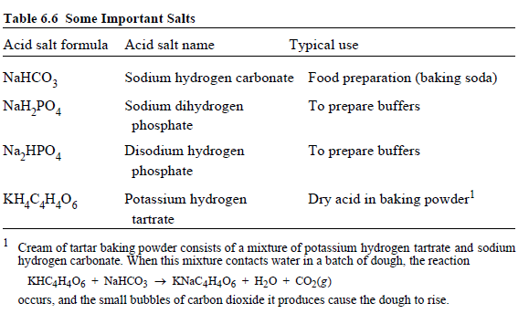
Acid salts

Slide 83
Basic Salts
Some salts contain hydroxide ions.
These are known as basic salts. One of the
most important of these is calcium hydroxyapatite, Ca5OH(PO4)3.
Commonly known as hydroxyapatite, this salt occurs in the mineral rock phosphate, which is the source of essential phosphate fertilizer.
The heavy metals, in particular, have a tendency to form basic salts.
Many rock-forming minerals are basic salts.

Slide 84
WATER OF HYDRATION
Water is frequently bound to other chemical compounds. Water bound to a salt in a definite proportion is called water of hydration.
An important example is sodium carbonate decahydrate:
Na2CO3 • 10 H2O (Sodium carbonate decahydrate)
This salt is used in detergents, as a household cleaner, and for water softening.
When dissolved in water, it yields a basic solution by reacting with the water to produce hydroxide ion, OH-.
Such a solution tends to dissolve grease, so it can be used as a household cleaner.
Sodium carbonate decahydrate is used in detergents, because they work best in basic solutions. The carbonate ion from this salt reacts with calcium ion (which causes water hardness),
Ca²⁺ + CO3 ²⁻ → CaCO3(s)

Slide 85
.
This removes hardness from the water by producing solid calcium carbonate, CaCO3.
Because of its ability to remove water hardness, sodium carbonate decahydrate is a good water softener, another reason that it is used in detergents.
Sodium carbonate without water, Na2CO3, is said to be anhydrous.
It should not be used in consumer products such as powdered detergents because of its strong attraction for water.
If anhydrous Na2CO3 were present in a detergent that was accidentally ingested, it would draw water from the tissue in the mouth and throat, greatly increasing the harm done.

Slide 86
NAMES OF ACIDS, BASES, AND SALTS Acids
Acids consisting of hydrogen and one other element are named for the element with a hydro- prefix and an ending of -ic.
These acids include HF, hydrofluoric; HCl, hydrochloric; HBr, hydrobromic; and H2S, hydrosulfuric acid.
Another acid named in this manner is HCN, hydrocyanic acid.
The names of many common acids end with the suffix -ic, as is the case with acetic acid, nitric acid (HNO3), and sulfuric acid.
In some cases where the anion of the acid contains oxygen, there are related acids with different numbers of oxygen atoms in the anion.
When this occurs, the acid with one less oxygen than the “-ic” acid has a name ending with -ous. For example, H2SO4 is sulfuric acid and H2SO3 is sulfurous acid.
Similarly, HNO3 is nitric acid and HNO2 is nitrous acid. One more oxygen in the anion than the “-ic” acid is indicated by a per- prefix and an –ic suffix on the acid name.
One less oxygen in the anion than in the “-ous” acid give the acid a name with a hypo- prefix and an -ous suffix. These rules are shown for the oxyacids (acids containing oxygen in the anion) of chlorine in Table .

Slide 87
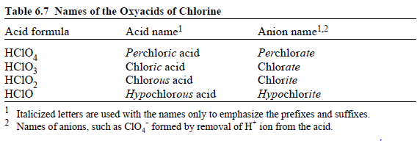
Oxyacids of Chlorine

Slide 88
Naming Bases
Bases that contain hydroxide ion are named very simply by the rules of nomenclature for ionic compounds.
The name consists of the name of the metal followed by hydroxide.
As examples, LiOH is lithium hydroxide, KOH is potassium hydroxide, and Mg(OH)2 is magnesium hydroxide.

Slide 89
Naming Salts
Salts are named according to the name of the cation followed by the name of the anion.
The names of the more important ions are listed in Table 6.8.
One important cation, ammonium ion, NH4 +, and a number of anions are polyatomic ions, meaning that they consist of 2 or more atoms per ion.
Table 6.8 includes some polyatomic ions. Note that most polyatomic ions contain oxygen as one of the elements.
As illustrated in Table 6.8, the names of anions are based upon the names of the acids from which they are formed by removal of H+ ions.
A “hydro -ic” acid yields an “-ide” anion and, therefore, an “-ide” salt.
For example, hydrochloric acid reacts with a base to give a chloride salt.
An “-ic” acid yields an “-ate” salt; for example, calcium sulfate is the salt that results from a reaction of sulfuric acid with calcium hydroxide.

Slide 90
Naming
The anion contained in an “-ous” acid is designated by the suffix “-ite” in a salt; sulfurous acid, H2SO3 reacts with NaOH to give the salt Na2SO3 sodium sulfite.
A “per -ic” acid, such as perchloric acid, reacts with a
base, such as NaOH, to give a “per -ate” salt, for example, sodium perchlorate, NaClO4.
A “hypo -ous” acid, such as hypochlorous acid, reacts with a base, KOH, for example, to give a “hypo -ite” salt, such as potassium hypochlorite, KClO.
Some additional examples are illustrated by the following reactions:

Slide 91
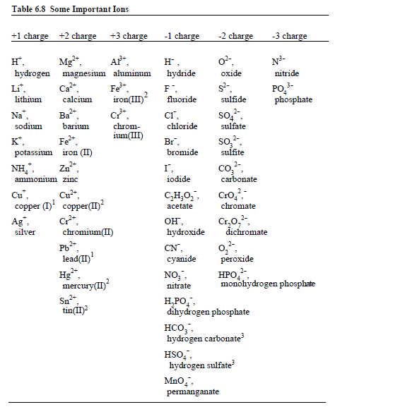
.

Slide 92
.
1 These metals can also exist as ions with a higher charge and may also be designated by their Latin names with an -ous ending as follows: Cu+, cuprous; Fe2+, ferrous; Cr2+, chromous; Pb2+, plumbous; Mn2+, manganous; Sn2+, stannous.
2 These metals can also exist as ions with a lower charge and may also be designated by their Latin names with an -ic ending as follows: Cu2+, cupric; Hg2+, mercuric; Fe3+, ferric; Cr3+, chromic.
3 The ions HCO3 - and HSO4 - are known as bicarbonate and bisulfate, respectively.

Slide 93
Chemical Formula
Using the information given in Table 6.8, it is possible to figure out the formulas and give the names of a very large number of ionic compounds. To do that, simply observe the following steps:
1. Choose the cation and the anion of the compound. The name of the compound is simply the name of the cation followed by the name of the anion. For example, when Fe3+ is the cation and SO4 ²⁻ is the anion; the name of the ionic compound is iron(III) sulfate.

Slide 94
.
2.Choose subscripts to place after the cation and anion in the chemical formula of the compound such that multiplying the subscript of the cation times the charge of the cation gives a number equal in magnitude and opposite in sign from that of the product of the anion’s subscript times the anion’s charge.
In the example of iron(III) sulfate, a subscript of 2 for Fe³⁺ gives 2 x (3+) = 6+, and a subscript of 3 for SO4 ²⁻ gives 2 x (3-) = 6-, thereby meeting the condition for a neutral compound
3. Write the compound formula. If the subscript after any polyatomic ion is greater than 1, put the formula of the ion in parentheses to show that the subscript applies to all the atoms in the ion.
Omit the charges on the ions because they make the compound formula too cluttered.
In the example under consideration, the formula of iron(III) sulfate is Fe2(SO4)3.

Slide 95
.
Exercise: Match each cation in the left column below with each anion in the right column and give the formulas and names of each of the resulting ionic compounds.
(a) Na+ (1) Br-
(b) Ca²⁺ (2) CO3 ²⁻
(c) Al³⁺ (3) PO4 ³⁻
Answers:
a-1, NaBr, sodium bromide; a-2, Na2CO3, sodium carbonate; a-3,
Na3PO4, sodium phosphate;
b-1, CaBr2, calcium bromide; b-2, CaCO3, calciumcarbonate; b-3, Ca3(PO4)2, calcium phosphate;
c-1, AlBr3, aluminum bromide; c-2,A12(CO3)3, aluminum carbonate; c-3, AlPO4, aluminum phosphate.

Slide 96
.
The names and formulas of ionic compounds that contain hydrogen in the name and formula of the anion are handled just like any other ionic compound.
Therefore, NaHCO₃ is sodium hydrogen carbonate, Ca(H₂PO₄)₂ is calcium dihydrogen phosphate, and K2HPO4 is sodium monohydrogen phosphate.

Slide 97

.
The acetate ion, C₂H₃O₂ ⁻ also contains hydrogen, but, as noted previously, its hydrogen is covalently bonded to a C atom, as shown by the structure and cannot form H+ ions, whereas the anions listed with hydrogen in their names can produce H+ ion when dissolved in water.

Slide 98
CHAPTER SUMMARY Acids, Base and Salts
The chapter summary below is presented in a programmed format to review the main points covered in this chapter. It is used most effectively by filling in the blanks, referring back to the chapter as necessary. The correct answers are given at the end of the summary.
1____ ion is produced by acids and 2____ by bases.
A neutralization reaction is 3____ .
Hydrogen ion, H+, in water is bonded to 4____ and is often represented as 5 ____ .
A base is a substance that accepts H+ and produces hydroxide ion.
Although NH3 does not contain hydroxide ions, it undergoes the reaction 6____ to produce OH- in water.
The two products produced whenever an acid and a base react together are 7 ____ .
A salt is made up of 8 ____ .
An amphoteric substance is one that 9____ .

Slide 99
CHAPTER SUMMARY Acids, Base and Salts
In water, a metal ion is bonded to 10 ____ in a form known as a 11 ____ .
In terms of acid–base behavior, some metal ions act as 12 ____ .
In water solution sodium carbonate acts as a 13 ____ and undergoes the reaction14____ .
Salts that act as acids react with 15____ . Pure water conducts electricity 16 ____ , a solution of acetic acid conducts electricity 17 ____ , and a solution of HCl conducts electricity 18 ____ .
These differences are due to differences in concentrations of 19 ____ in the water.
Materials that conduct electricity in water are called 20 ____.
Materials that do not form ions in water are called 21 ____.
The reaction CH3CO2H → CH3CO2 - + H+ (6.4.1)
may be classified as 22____ or 23____ and when the acetic acid molecule comes apart, it is said to 24 ____

Slide 100
CHAPTER SUMMARY Acids, Base and Salts
A base that is completely dissociated in water is called a 25____ and an acid that is only slightly dissociated is called a 26 ____.
At high concentrations the percentage of dissociation of a weak acid is 27____ than at lower concentrations.
Buffers are 28____ .A buffer can be made from a mixture of a weak base and 29 ____
The reaction that results in the production of very low concentrations of ions in even pure water is 30 ____ and the relationship between the concentrations of these ions in water is 31 ____.
In absolutely pure water the value of [H+] is exactly 32 ____ , the pH is 33____
, so that the solution is said to be 34 ____ .
Acidic solutions have pH values of 35 ____ and basic solutions have pH values of 36 ____.
In a general sense solution equilibrium deals with the extent to which reversible acid-base, solubilization (precipitation), complexation, or oxidation-reduction reactions 37____.

Slide 101
CHAPTER SUMMARY Acids, Base and Salts
As an example of acid-base equilibrium the reaction for the ionization of acetic acid, HAc, is 38____ for which the acid dissociation constant is 39____ .
The reaction of an ion with water such as
PO4 3- + H2O → HPO4 2- + , OH is an example of a 40____ .
The most obvious way to prepare a salt is by 41 ____ .
Active metals react with acids to produce 42____ .
Other than reacting with acids, some metals react with 43___ .
If the anion in a salt can form a volatile acid, a new salt can be formed by 44____.
Some metals will displace other metals from a salt. If magnesium, a highly reactive metal is added to a solution of copper sulfate, the reaction that occurs is 45____.
NaHSO4, which has an ionizable hydrogen, is an example of 46____ , whereas Ca5OH(PO4)3 is an example of 47 ____ .

Slide 102
CHAPTER SUMMARY Acids, Base and Salts
The water in CuSO4 •5H2O is called 48____ .
The names of HClO4, HClO3, HClO2, and HClO are, respectively, 49 ____.
The names of NaClO4, NaClO3, NaClO2, and NaClO are, respectively, 50 ____.
The name of a base containing a metal consists of 51____ .
As examples, LiOH is lithium hydroxide, KOH is potassium hydroxide, and Mg(OH)2 is magnesium hydroxide. The name of a salt is 52____ .
The names of the ions Ca2+, Fe3+, H-, SO3 2-, and C2H3O2 - are, respectively, 53 ____.

Slide 103
CHAPTER SUMMARY Acids, Base and Salts
In writing the formulas of ionic compounds, choose subscripts to place after the cation and anion in the chemical formula of the compound such that multiplying the subscript of the cation times the charge of the cation gives a number 54____ and opposite in sign from that of the product of 55___.

Slide 104
,
☺
THE END

Slide 105
pH, pOH, and the pH scale
Definitions of pH, pOH, and the pH scale. Calculating the pH of a strong acid or base solution. The relationship between acid strength and the pH of a solution.

Slide 106
Key points
We can convert between [H]and pH using the following equations:
pH=−log⁡[H+]
[H+]=10⁻
pH[H+]=−log[H+]=10−pH
We can convert between [OH−] and pOH using the following equations:
pOH=−log⁡[OH−]
[OH−]=10^{−pOH}
For any aqueous solution at 25∘:
pH+pOH=14
For every factor of 10 increase in concentration of [H+], pH will decrease by 1 unit, and vice versa.
Both acid strength and concentration determine [H+] and [pH] .

Slide 107
.
Introduction
In aqueous solution, an acid is defined as any species that increases the concentration of H+(aq), while a base increases the concentration of OH−(aq).
Typical concentrations of these ions in solution can be very small, and they also span a wide range.
Purple-blue hydrangeas next to pinkish purple hydrangeas.
The color of hydrangea flowers can vary depending on the pH of the soil. Blue flowers usually come from acidic soil with a pH less than 6, and and pink flowers come from soil with a pH above 6.
Photo from Wikimedia Commons, CC BY 2.0

Slide 108
mm

